Slide 1


FEASIBILITY PRESENTATION
Object Detection, Tracking, and Suspicious Activity Recognition for Maritime Surveillance using Thermal Vision
Department of Electronic and Telecommunication Engineering
University of Moratuwa

Slide 2

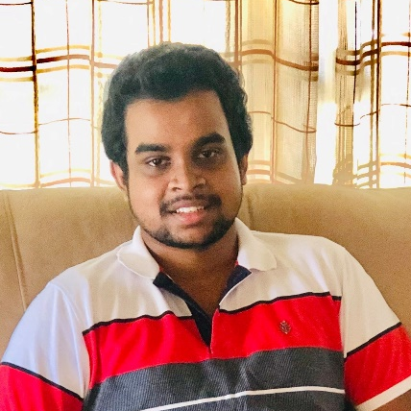


Group Members
160005C
K.G. Abeywardena
160243D
H.L.S.H. Jayasundara
160285G
G.K.S.R. Karunasena
160616B
S.K. Sumanthiran
Supervisors
Dr. Peshala Jayasekara Dr. Ranga Rodrigo

Slide 3
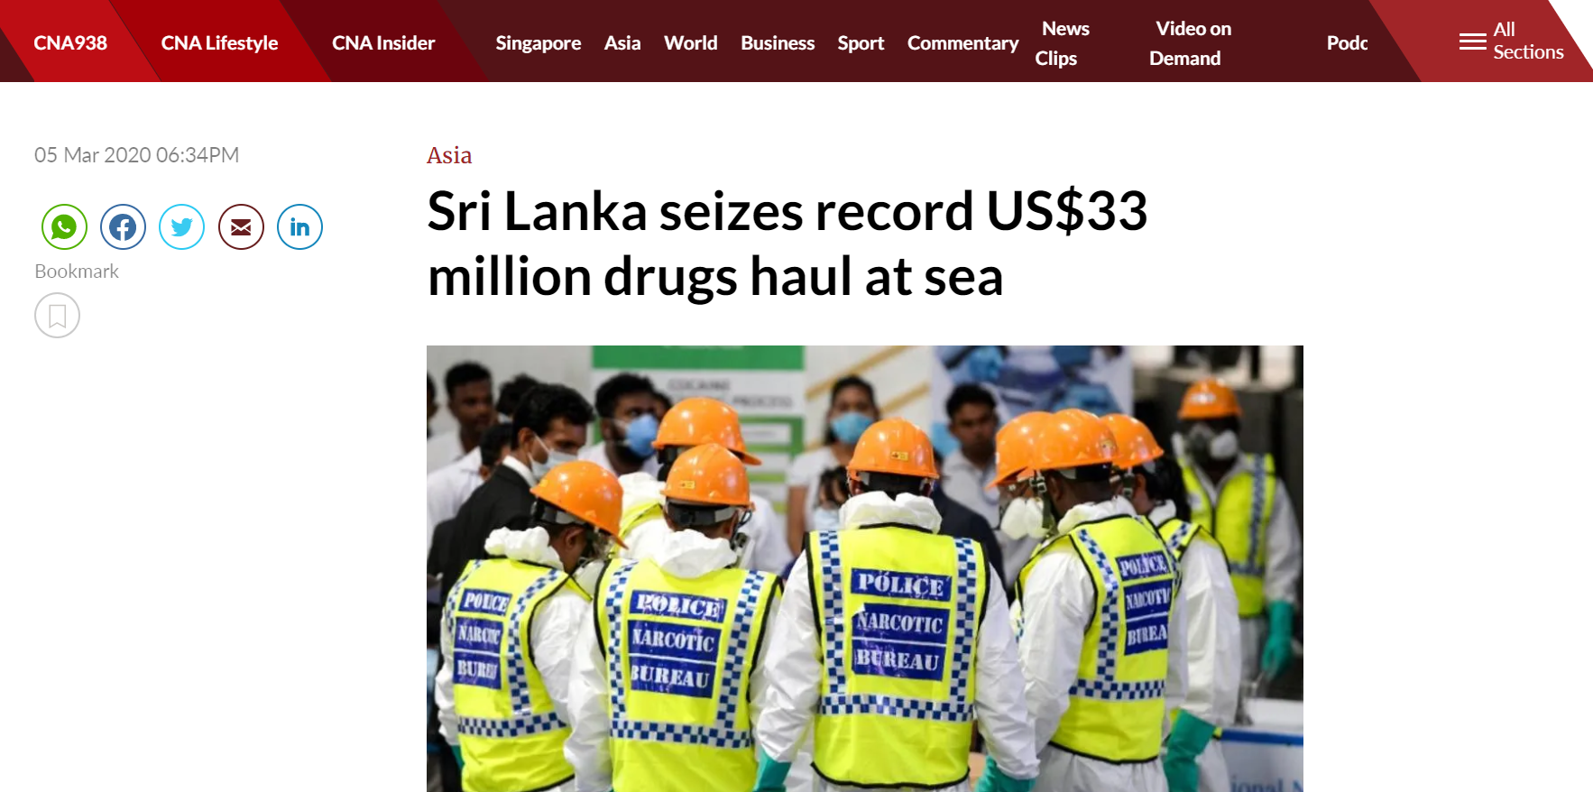
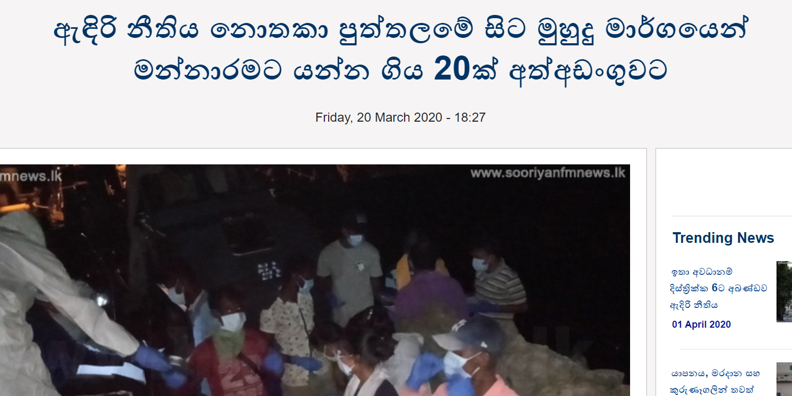
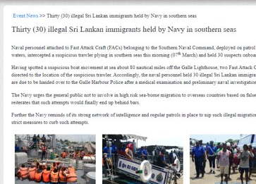
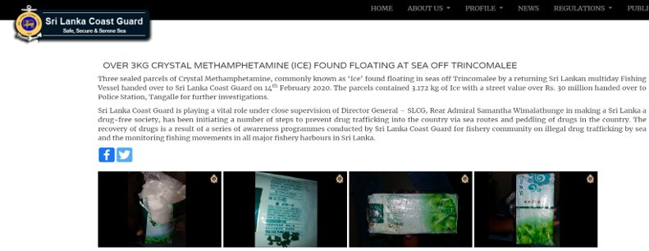

Slide 4
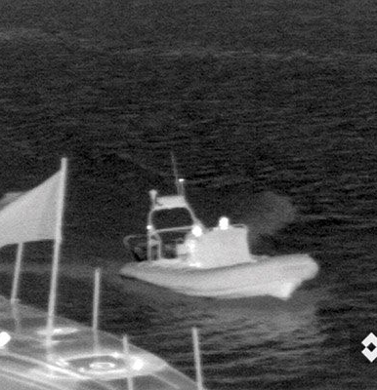
Constant surveillance is essential in border protection and eradicating illegal maritime activities.
In the recent past, Sri Lankan seas have recorded major narcotic busts within a short period of time. Also, Indian fishermen crossing the border to Sri Lankan waters is a common news headline today.
Are these activities always traceable and identifiable? Vessel crew can make errors due to the fatigue induced by the monotony of tasks involved in surveillance in maritime environments.
The conventional surveillance methods are ineffective, labor intensive, and expensive due to the repetitive work involved in maritime surveillance.
Problem Statement

Slide 5
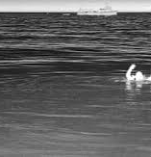
Detect pre-defined objects using a thermal camera in seawaters.
Detect suspicious activities occurring in any given area in the sea.
Track and record the suspicious actor and alert the authorities.
Create an annotated maritime thermal dataset for object detection and activity detection.
Primary Objectives

Slide 6
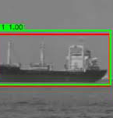
Develop algorithms to carry out detection and bounding box estimation of dynamic targets such as boats, boat riders, swimmers and other floating objects.
Tracking of such targets using active control of the thermal camera.
Define and recognize suspicious activities using thermal imagery in maritime environment
Creation of an annotated maritime thermal image dataset for object detection and activity detection
Develop a platform to stabilize and control the thermal camera.
Develop a well-documented software to monitor and control all components
Scope

Slide 7
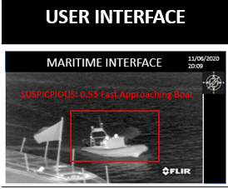
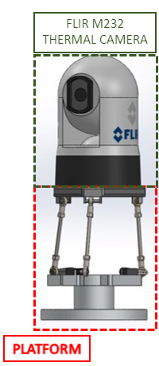
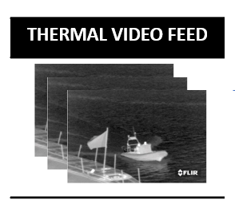
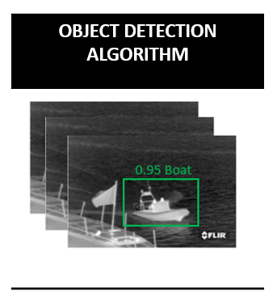
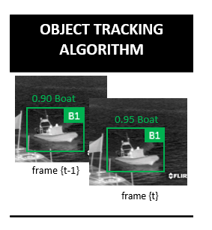
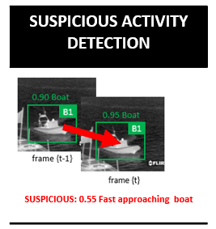
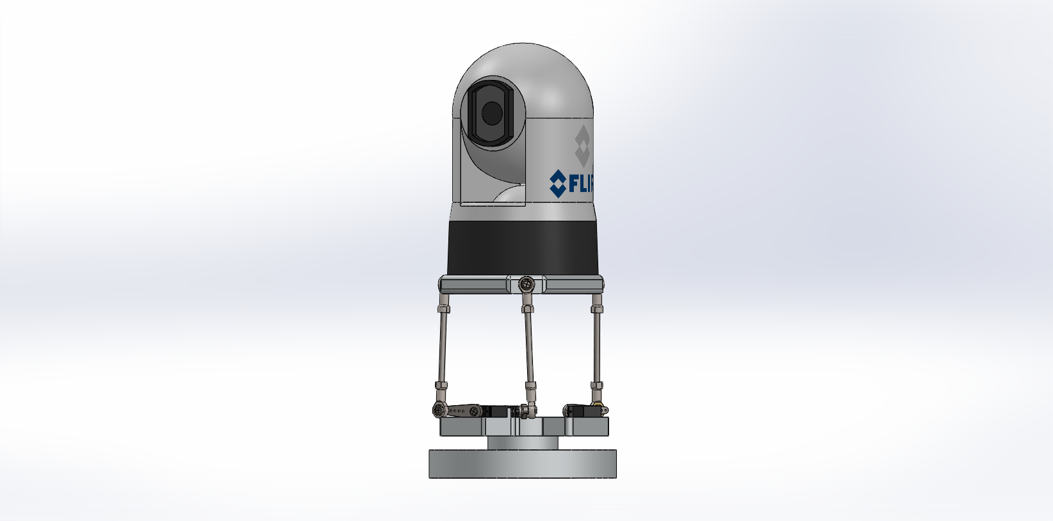
Proposed Architecture
Dumping objects
Unauthorized fishing
Loitering
Evasive actions
Human Trafficking
CONTROL SYSTEM
IMU READINGS – current camera pos

Slide 8
Proposed Architecture
Dumping objects
Unauthorized fishing
Loitering
Evasive actions
Human Trafficking
CONTROL SYSTEM
IMU READINGS – current camera pos

Slide 9
Object Detection Algorithms
Activity Detection Algorithms
Inference Hardware
Platform Design
Hardware comparison
Control System
Software Backend framework
Software Frontend design framework
Evaluation of Alternative Methods

Slide 10
Evaluation of Alternatives – Object Detection Algorithms
 | Faster-RCNN* ^{[1]} | SSD512* ^{[2]} | Yolo-V3* ^{[3]} | R-FCN* ^{[4]} | CornerNet ^{[5]} | CenterNet ^{[6]} | CornerNet-Lite (Saccade) ^{[7]} | CornerNet-Lite (Squeeze) ^{[7]}
Backbone | VGG-16 | VGG-16 | DarkNet-19 | ResNet – 101 | Hourglass – 104 | Hourglass – 104 | Hourglass – 52 | Squeezed Hourglass
Single/ Double Stage | Double | Single | Single | Double | Single | Single | Single | Single
FPS | 5 | 19 | 45 | 6 | 1 | 1 | 10 | 60
mAP % | 21.9 | 28.8 | 21.6 | 29.9 | 37.8 | 41.6 | 38 | 34
*RCNN - Region-based Convolutional Neural Network
*SSD – Single Shot Detector
*YOLO – You Only Look Once
*R-FCN - Region-based Fully Convolutional Network

Slide 11
Evaluation of Alternatives – Activity Detection Algorithms
​ | Gaussian Temporal Awareness Networks (GTAN)​ ^{[9]} | Temporal Recurrent Networks (TRN)​ ^{[10]} | Reinforced Encoder- Decoder Networks (RED)​ ^{[11]} | A structured Model for Action Detection​ ^{[12]} | Spatio-Temporal Progressive Learning(STEP)^{​ [13]} | Online Real-time Multiple Spatio-temporal Action Localization and Prediction​ ^{[14]}
Temporal/Spatio-temporal​ | Temporal​ | Temporal​ | Temporal​ | Spatio-Temporal​ | Spatio-Temporal​ | Spatio-Temporal​
Backbone​ | Pseudo-3D​ | VGG-16 / ResNet-200​ | VGG-16 / ResNet-200​ | ResNet-50/Mask-RCNN​ | VGG-16​ | VGG-16​
Online/Offline​ | Offline​ | Online​ | Online​ | Offline​ | Offline​ | Online​
FPS​ | 8​ | 24​ | 24​ | 12​ | 21​ | 28​
Dataset​ | THUMOS’14​ | THUMOS’14​ | THUMOS’14​ | UCF101​ | UCF101​ | UCF101​
mAP score​ | 38.8​ | 47.2​ | 45.3​ | 77.9​ | 75.0​ | 43.0​

Slide 12
Evaluation of Alternatives – Inference Hardware
 | Titan RTX | GeForce GTX 1080 Ti | GeForce GTX 1660 Ti | GeForce RTX 2060 | GeForce GTX 1650 Ti | Radeon RX 590
Cuda Support | Yes | Yes | Yes | Yes | Yes | No
RAM (GB) | 24 | 11 | 6 | 6 | 4 | 8
Memory Bandwidth (GB/s) | 672 | 484 | 192 | 336 | 128 | 256
Power (W) | 280 | 250 | 120 | 160 | 75 | 175
Price (Rs.) | Rs. 500,000 | Rs. 160,000 | Rs. 56,000 | Rs. 65,000 | Rs. 30,000 | Rs. 36,000

Slide 13
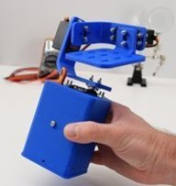
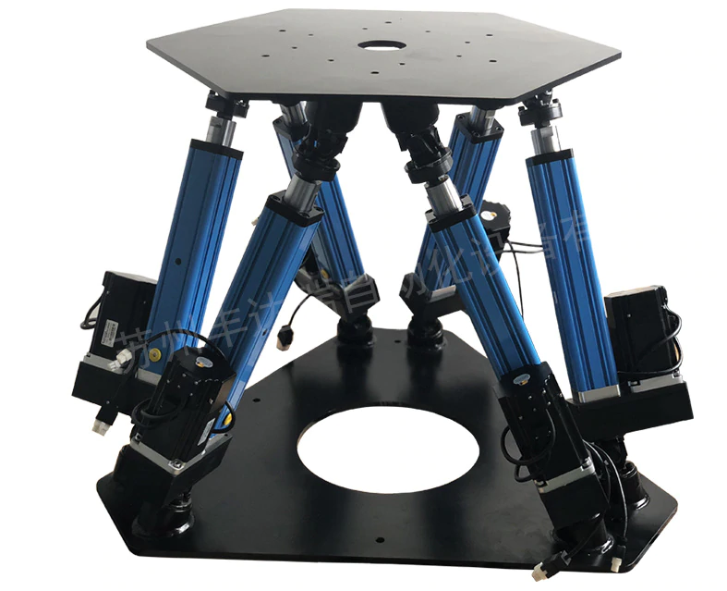
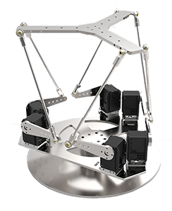
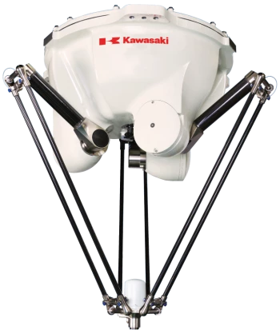
Evaluation of Alternatives - Platform Design
 | Serial-Link-Arm based platform | Stewart platform with prismatic actuators (6-DoF) | Stewart platform with rotary actuators (6-DoF) | Delta robot platform (6-DoF)
Stability of Platform | Moderate | High | Moderate | Moderate
Positioning Accuracy | Low | High | High | High
Force-to-Weight ratio | Low | High | High | High
Rigidity (off-axis) | Low | High | Moderate | Moderate
Size of Platform | Small - Medium | Large | Small - Medium | Small - Large
Cost | Low | High | Moderate | Moderate
Mass of Load | Low/Moderate | High | Moderate | Low
Speed of action | Moderate | Moderate | High | High
Workspace Volume | Moderate | Small | Small | Small

Slide 14
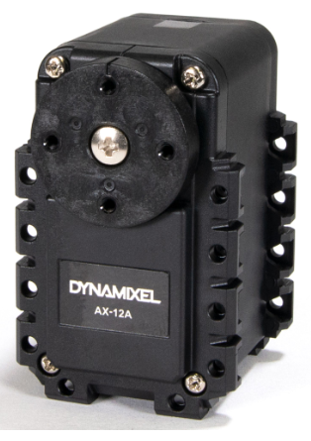
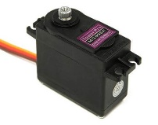
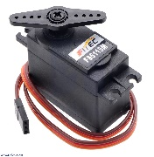
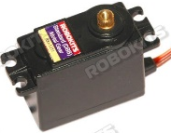
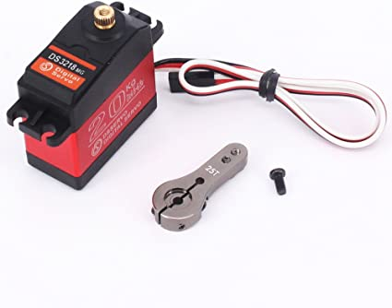
Evaluation of Alternatives – Hardware – Servo Motors
 | MG996R | FS5115M | RKI-1211 | Dynamixel AX-12A | DS3218
Gear Material | Metal | Metal | Metal | Metal | Metal
Stall Torque | 9.4 kgf.cm (4.8 V ) 11 kgf.cm (6 V) | 14kgf.cm (4.8V) 15.5kgf.cm (6V) | 14kgf.cm (4.8V) 16kgf.cm (6V) | 15.3 kg·cm 212 oz·in | 18kgf.cm(6V), 20kgf.cm(7.2V)
Operating Speed | 0.17 s/60⁰ (4.8 V) 0.14 s/60⁰ (6 V) | 0.18 s/60⁰ (4.8V) 0.16 s/60⁰ (6V) | 0.18 s/60⁰ (4.8V) 0.14 s/60⁰ (6V) | 59 RPM 0.169sec/60° | 0.14 s/60⁰ (6V) 0.16 s/60⁰ (7.2V)
Operating Voltage | 4.8V – 7.2V | 4.8V – 7.2V | 4.8V – 6.0V | 9V - 12V | 4.8V – 7.2V
Dead Bandwidth | 5µs | 5µs | 5µs | 2µs | 3µs
Weight | 55g | 56g | 48g | 55g | 60g
Dimensions (mm) | 40.7 x 19.7 x 42.9 | 40.8 × 20.1 × 38 | 41 x 20 x 36 | 50× 26 × 37.5 | 40 x 20 x 40.5
Cost ($) | 3 | 19 | 22 | 47 | 12
Notes:
Dynamixel is the most proffesional motor but we don't choose that because we need an extra ciruits to communicate with the motor via serial communication and driving. Twise as cost as a normal servo

Slide 15
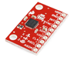
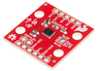
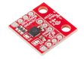
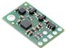
Evaluation of Alternatives – Hardware – IMU*
 | MPU 6050 | LSM6DS3 | MPU9250 | Mini IMU 9
Special Features | 6 or 9-axis Motion Fusion data in rotation matrix, quaternion, Euler Angle, or raw data format 3-Axis accelerometer with a programmable full-scale range of ±2g, ±4g, ±8g and ±16g | “Always on” experience with low power consumption for both accelerometer and gyroscope | 3 axis silicon monolithic Hall-effect magnetic sensor with magnetic concentrator Digitally programmable low-pass Gyroscope filter Includes gyroscope, accelerometer and magnetometer | Pololu MinIMU-9 v2 packs a L3GD20 3-axis gyro, a LSM303DLHC 3-axis accelerometer and 3-axis magnetometer. I²C interface accesses nine independent rotation, acceleration, and magnetic measurements to calculate the sensor’s absolute orientation
Sensitivity | 131, 65.5,32.8, 16.4 | 228.57, 114.29, 57.14, 28.57, 14.29 | 131, 65.5,32.8, 16.4 | 114.29, 57.14, 14.29
ARW* | 0.005 | 0.007 | 0.01 | 0.03
Non-Linearity | 0.2 | 0.5 | 0.1 | 0.2
Unit Price ($) | 3 | 8 | 7 | 15.95
*IMU – Inertial Measurement Unit
*ARW – Angle Random Walk (Noise)
Notes:
IMU – Inertial Measurement Unit
Sensitivity high
Noise low non linearity low
Magnetometer ekak have
Vendor is pololu.

Slide 16
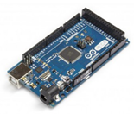
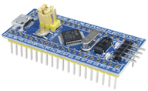
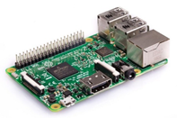
Evaluation of Alternatives – Hardware – Microcontroller
 | Arduino Mega | STM32 | Raspberry Pi 3B+
Affordability (Financially) | High | High | Moderate
Computational Power | Low | Moderate | High
Most Optimized Task | Logic Programming | Logic Programming | General Single Board Computer
WiFi and Bluetooth | No | No | Yes
Power Consumption | ~ 0.5 W | ~ 0.5 W | ~ 5 W
Notes:
We need a microcontroller with high computational power for the digital video stabilization and sometimes we might need to communicate with the camera and an external computer. So we need WiFi or bluetooth capabilities as well as the ability to deal with image processing libraries .

Slide 17
Evaluation of Alternatives – Control System
Joint-Space Controller | Cartesian Space Controller
Attempts to null the joint parameter error by commanding a torque signal to servo-drive | Attempts to null the cartesian coordinate error by commanding a torque signal to servo-drive
Dynamic equations are complicated | Dynamic equations are less complicated
Need 6, 1-DoF sensors to measure the joint parameters at each joint (d or theta) | Need 6-DoF sensor to measure the position and the orientation of the platform
Notes:
Related to our stewart platform design
Controlled using the rotating speed of the motor axis, position of the servo arm used as parameters. We use orientations of the joints
We use orientation of the platform

Slide 18





Evaluation of Alternatives – Backend Development
Flask ^{[15]} Python based Very flexible More lightweight than Django, great for smaller projects Great documentation Offers the ability to build prototypes quickly | Django ^{[16]} Python Based Highly customizable No need to reinvent the wheel, encourages rapid development Very scalable Extensive community and documentation | Elixir Based ^{[17]} Very fast Fault tolerant Built in database options Well designed Great documentation and active community | Java Based ^{[18]} Create stand-alone Spring applications Highly scalable Great documentation Built for large scale applications that use a cloud approach Extensive ecosystem | Node.js Based ^{[19]} Great routing API Minimalistic and unopinionated Setup is easy and it's straightforward to learn Large number of plugins available for use
Notes:
We choose this framework because it is easy to learn and python based as well as very flexible, powerful and easy to make prototypes quickly

Slide 19




Evaluation of Alternatives – Frontend Development
React ^{[20]} Maintained by Facebook The community is constantly evolving Virtual DOM* High performance Suitable for applications with high traffic Often updated | Angular ^{[21]} Strong community 2-way data binding Simple single page app Shadow DOM Typescript | Angular JS ^{[22]} JavaScript friendly compared to Angular 2-way data binding Fast development Highly testable applications | JQuery ^{[8]} Beginner friendly Compatible with all browsers Ease of use A lot of plugins Big community
*Virtual DOM (VDOM) is a programming concept where an ideal, or “virtual”, representation of a UI is kept in memory and synced with the “real” DOM by a library such as ReactDOM
Notes:
We choose this framework because this is the most popular and oftrn updated framework. High performance and suitable for applications with high traffic.

Slide 20
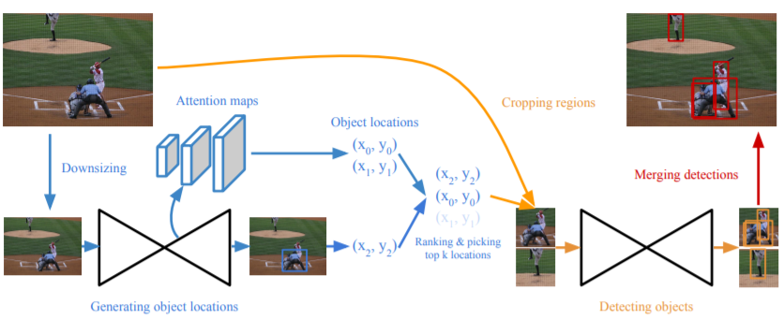
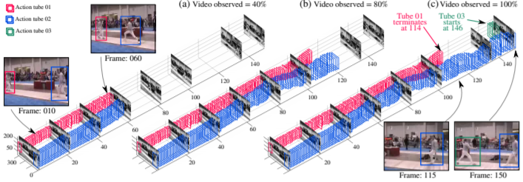
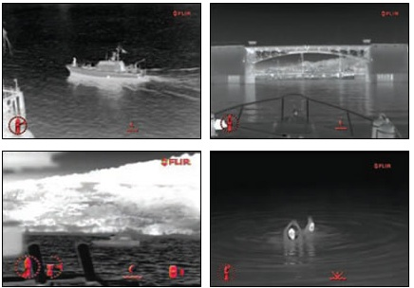
1
Functioning Object Detection algorithm
Deliverables
For objects related to maritime environment such as boats, swimmers etc.
Competitive mAP score on predicted bounding boxes
Using thermal images.
Functioning Activity Detection algorithm
2
Identifying at least 3-classes of pre-defined suspicious activities.
With competitive mAP score.
Using thermal image sequences.
3
Annotated maritime dataset
Capable of use for object detection and activity detection in maritime environment.
Either a locally obtained thermal dataset or already published maritime thermal dataset.
Publication in a well-known forum.
Camera mounting platform with
4
Stabilization.
Active control for object tracking
5
Well documented software
User-friendly
With automated alerts

Slide 21

Uniqueness
Automation of real-time threat detection at sea during the night.
Alerting relevant authorities upon detection of suspicious activities
Deep learning-based activity detection on marine objects using thermal images
Minimizes human intervention in watching for suspicious activities.

Slide 22
Potential Customers
Navy
Coast Guard
Photographers
Other Researchers
22

Slide 23
Risk Factors – Technical Risks
Risk | How to mitigate
Might not be able to use the pan and tilt abilities of the camera. | Controlling the orientation of camera using the designed platform.
Stabilization of platform will not be possible to achieve entirely from Gyro-PID based controller. | Use digital video stabilization techniques to stabilize the video feed alongside with the mechanical stabilizer.
Documented motor and servo parameters being different from actual values of the motors obtained. | Perform physical testing of the motors obtained and adjust the control loop parameters
Workspace volume of the platform not sufficient | Creating and simulating multiple platform designs with different dimensions and different DOFs (6 –DOF and 3-DOF)
Unable to run the currently selected pipeline in real time. | Use smaller, faster algorithms, and use other techniques to improve the accuracy of the model

Slide 24
Risk Factors – Financial Risks
Risk | How to mitigate
Reordering cost for failing components. | Order with a buffer margin at first
Cost limit for the project exceeding the university stipend. | Self funding
Delivery cost of different vendors | Selecting a vendor based on the price of the component and customer feedback.
Risk Factors – Sustainability Risks
Risk | How to mitigate
Dataset collection on Sri Lankan sea with sufficient level of suspicious activities may take longer time | Do all the tasks based on available datasets obtained in foreign seas
Components may not arrive on time and depreciated components | Order components early and check whether they are in good quality

Slide 25
Risk Factors – Health Risks*
Risk | How to mitigate
Received packages from overseas may not have adhered to the safety measures from the vendors | Sanitization of the packages and selecting the vendors more carefully
Getting firsthand experience on how the suspicious activities are detected by SL Navy, how the movements and vibrations of vessels may affect the quality of our algorithms not possible due to the current context. | Contact personnel from SL Navy through a Zoom meeting and get their input when the situation is better
*Due to COVID-19

Slide 26
Budget
Item | Unit Price ($) | No of Units | Total ($) | Total (LKR) (1USD = LKR185) | Sponsored
FLIR M232 Thermal Camera | 3499 | 1 | 3499 | 645791.54 | Yes
DS3218 Servo | 11.20 | 8 | 89.6 | 16576 | No
Connecting Rods (4 per set) | 9 | 4 | 36 | 6660 | No
2s1p 5200mAh LiPo Battery | 40 | 1 | 40 | 7382.58 | No
Mini IMU 9 - Pololu | 16 | 2 | 32 | 5920 | No
Raspberry Pi 3 | 40 | 1 | 40 | 7382.58 | No
Base and top platforms Laser Cut (approx.) |  |  |  | 5,000 | No
GPU | 300 | 1 | 300 | 55,500 | Yes
Total Budget = LKR 750,212.7 ( Non-Sponsored = LKR 48921.16)

Slide 27
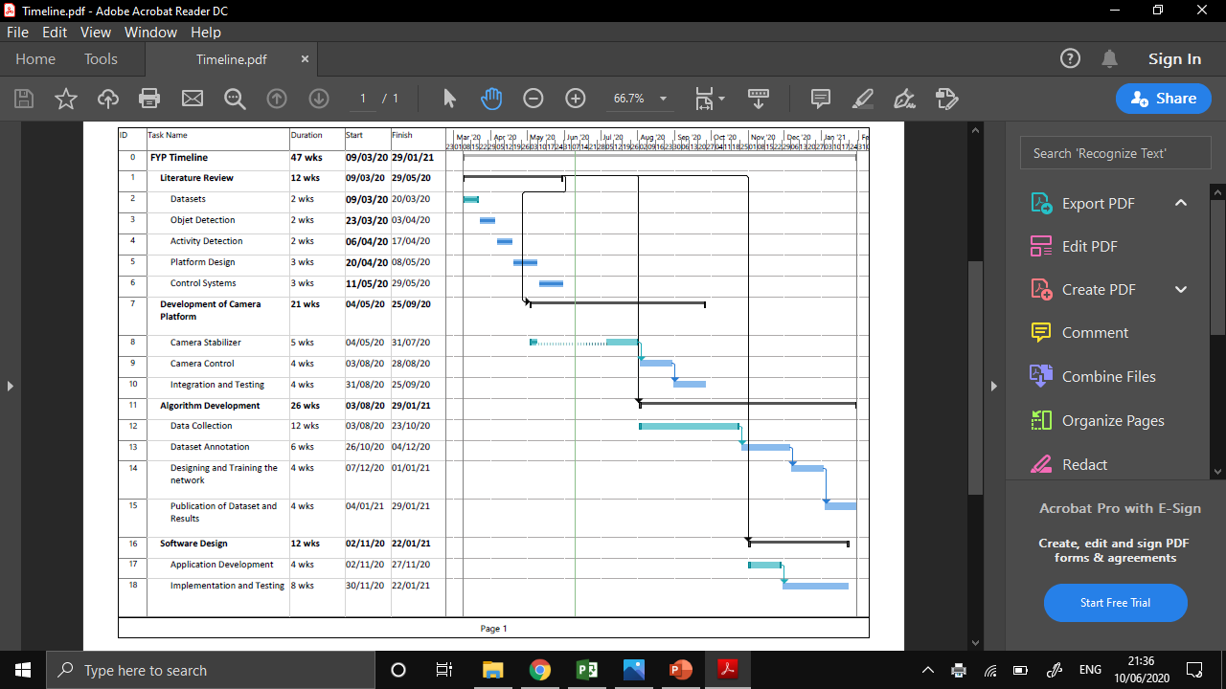
Timeline

Slide 28
Task Delegation
Task Group | Responsible Person | Tasks | Delegation
 |  |  | Kalana | Sakuna | Sachira | Shechem
Object Detection and Activity Detection | Shechem | Data Preprocessing |  | ✓ | ✓ | ✓
 |  | Data Annotation | ✓ | ✓ | ✓ | ✓
 |  | Algorithm Development and Training | ✓ | ✓ | ✓ | ✓
 |  | Object Tracking | ✓ |  | ✓ | ✓
Platform and Control System Design | Sachira | Platform Design | ✓ |  | ✓
 |  | Simulation | ✓ |  | ✓
 |  | Prototyping | ✓ | ✓ | ✓ | ✓
 |  | Control System and Programming | ✓ | ✓ |  | ✓
Integration | Kalana | Integration of Hardware and Software | ✓ | ✓ |  | ✓
Software Development | Sakuna | Backend Development |  | ✓ |  | ✓
 |  | Frontend Development |  | ✓ | ✓

Slide 29
Platform Design and simulation
Control Loop Design
Algorithm testing on Thermal Images
Alternative dataset search
Current Progress

Slide 30
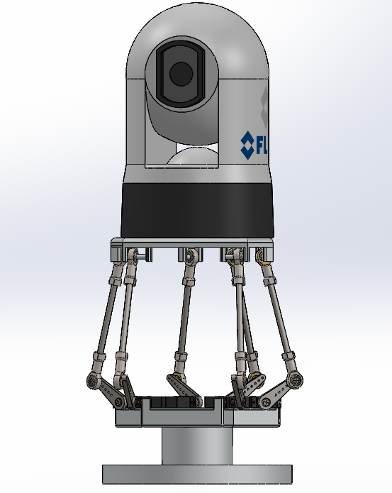
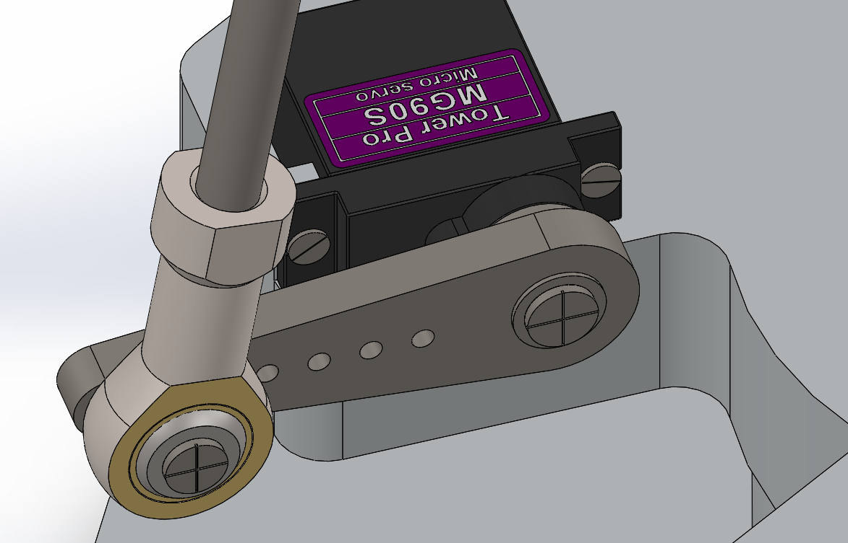
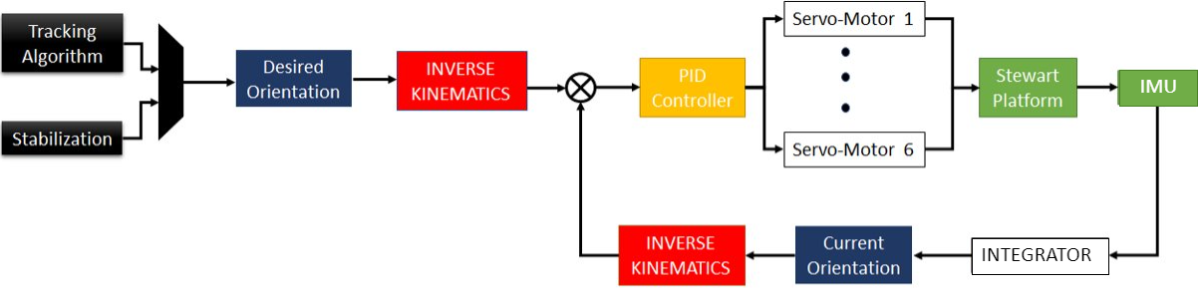
Platform Design and Simulation
6-DOF Stewart Platform
3-DOF Stewart Platform
Ball Joints Design and Servo Arm Design
Current Progress – Control System Design

Slide 31
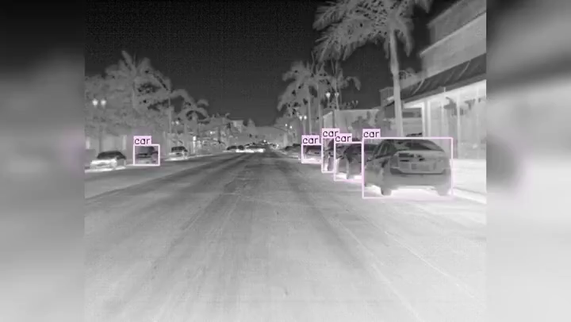
Current Progress – Algorithm testing on thermal images*
Property | Faster-RCNN ^{[1]} | Yolo-V3 ^{[3]} | R-FCN ^{[4]} | CornerNet ^{[5]} | CornerNet-Lite (Saccade) ^{[7]} | CornerNet-Lite (Squeeze) ^{[7]}
FPS | 5 | 45 | 6 | 1 | 10 | 60
mAP % | 65 | 85 | 78 | 88 | 65 | 81
*Algorithms are trained on FLIR Self Driving Thermal Image Dataset

Slide 32
Current Progress – Alternative Datasets
Datasets | Link | Images/ Video type | Description | Suitability
Singapore Maritime Dataset | https://sites.google.com/site/dilipprasad/home/singapore-maritime-dataset | Near IR videos | Near Infra-red (NIR) videos which is also captured using another Canon 70D camera with hot mirror removed and Mid-Opt BP800 Near-IR Bandpass filter. | Both the videos and the annotations files are provided Not captured from a thermal camera (hence the quality of the images may be not of the thermal cameras) No Suspicious activities included
IPATCH | http://ftp.pets.rdg.ac.uk/pub/PETS2016/MidHighLevelChallengeData/IPATCH/ | Both R and Thermal | Contains a set of fourteen multi camera recordings (visible, thermal) collected off the coast of Brest, France (Mainly the images are provided. For two thermal cameras, a summary video is provided per directory) | Dataset consists the following scenarios: -> boat detection and boat tracking -> Abnormal events such as boat speeding up , boat loitering , Group formation/separation -> Threat events: attack to the vessel Thermal images extracted from the video clips are all captured in daytime (Potential bias ) No object-level annotations are provided Quality of the thermal frames extracted are not of good quality

Slide 33
References
[1] Shaoqing Ren, Kaiming He, Ross Girshick, and Jian Sun. Faster r-cnn: Towards real-time object detection with region proposal networks. In Advances in neural information processing systems, pages 91–99, 2015
[2] Wei Liu, Dragomir Anguelov, Dumitru Erhan, Christian Szegedy, Scott Reed, Cheng-Yang Fu, and Alexander C Berg. Ssd: Single shot multibox detector. In European conference on computer vision, pages 21–37. Springer, 2016.
[3] J. Redmon and A. Farhadi, “YOLOv3: An Incremental Improvement,” arXiv preprint arXiv:1804.02767, 2018
[4] Jifeng Dai, Yi Li, Kaiming He, and Jian Sun. R-fcn: Object detection via region-based fully convolutional networks. In Advances in neural information processing systems, pages 379–387, 2016.
[5] Hei Law and Jia Deng. Cornernet: Detecting objects as paired keypoints. In Proceedings of the European conference on computer vision, pages 734–750, 2018.
[6] K. Duan, S. Bai, L. Xie, H. Qi, Q. Huang and Q. Tian, "CenterNet: Keypoint Triplets for Object Detection," 2019 IEEE/CVF International Conference on Computer Vision (ICCV)
[7] Law, Hei, Yun Teng, Olga Russakovsky, and Jia Deng. "Cornernet-lite: Efficient keypoint based object detection." arXiv preprint arXiv:1904.08900 (2019).
[8] js.foundation, J., 2020. Jquery. [online] Jquery.com. Available at: https://jquery.com/
[9] F. Long, T. Yao, Z. Qiu, X. Tian, J. Luo and T. Mei, "Gaussian Temporal Awareness Networks for Action Localization," 2019 IEEE/CVF Conference on Computer Vision and Pattern Recognition (CVPR)
[10] M. Xu, M. Gao, Y. Chen, L. Davis and D. Crandall, "Temporal Recurrent Networks for Online Action Detection," 2019 IEEE/CVF International Conference on Computer Vision (ICCV)
[11] Jiyang Gao, Zhenheng Yang and Ram Nevatia, "RED: Reinforced encode-decoder networks for action anticipation", BMVC, 2017.
[12] Y. Zhang, P. Tokmakov, M. Hebert and C. Schmid, "A Structured Model for Action Detection," 2019 IEEE/CVF Conference on Computer Vision and Pattern Recognition (CVPR)
[13] X. Yang, X. Yang, M. Liu, F. Xiao, L. S. Davis and J. Kautz, "STEP: Spatio-Temporal Progressive Learning for Video Action Detection," 2019 IEEE/CVF Conference on Computer Vision and Pattern Recognition (CVPR)
[14] G. Singh, S. Saha, M. Sapienza, P. Torr and F. Cuzzolin, "Online Real-Time Multiple Spatiotemporal Action Localisation and Prediction," 2017 IEEE International Conference on Computer Vision (ICCV)
[15] Flask.palletsprojects.com. 2020. Welcome To Flask — Flask Documentation (1.1.X). [online] Available at: https://flask.palletsprojects.com/en/1.1.x/
[16] Djangoproject.com. 2020. The Web Framework For Perfectionists With Deadlines | Django. [online] Available at: https://www.djangoproject.com/
[17] Phoenixframework.org. 2020. Peace-Of-Mind From Prototype To Production. [online] Available at: https://www.phoenixframework.org/
[18] Spring.io. 2020. Spring Boot. [online] Available at: https://spring.io/projects/spring-boot
[19] Expressjs.com. 2020. Express - Node.Js Web Application Framework. [online] Available at: https://expressjs.com/
[20] Reactjs.org. 2020. React – A Javascript Library For Building User Interfaces. [online] Available at: https://reactjs.org/
[21] Angular.io. 2020. Angular. [online] Available at: https://angular.io/
[22] Angularjs.org. 2020. Angularjs — Superheroic Javascript MVW Framework. [online] Available at: https://angularjs.org/

Slide 34
Thank you.

Slide 35
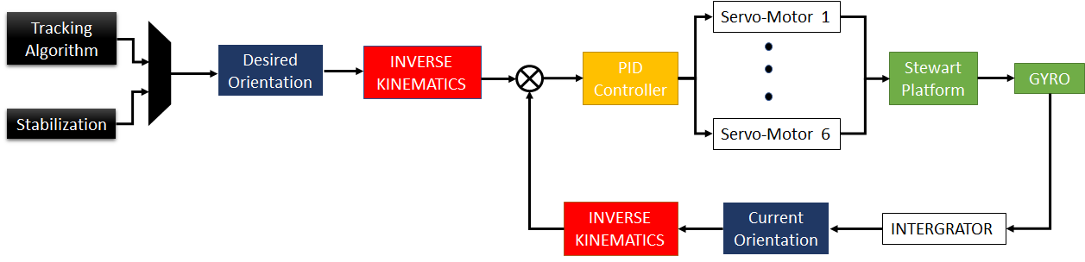
IMU
IMU
INTEGRATOR
INTEGRATOR

Slide 36
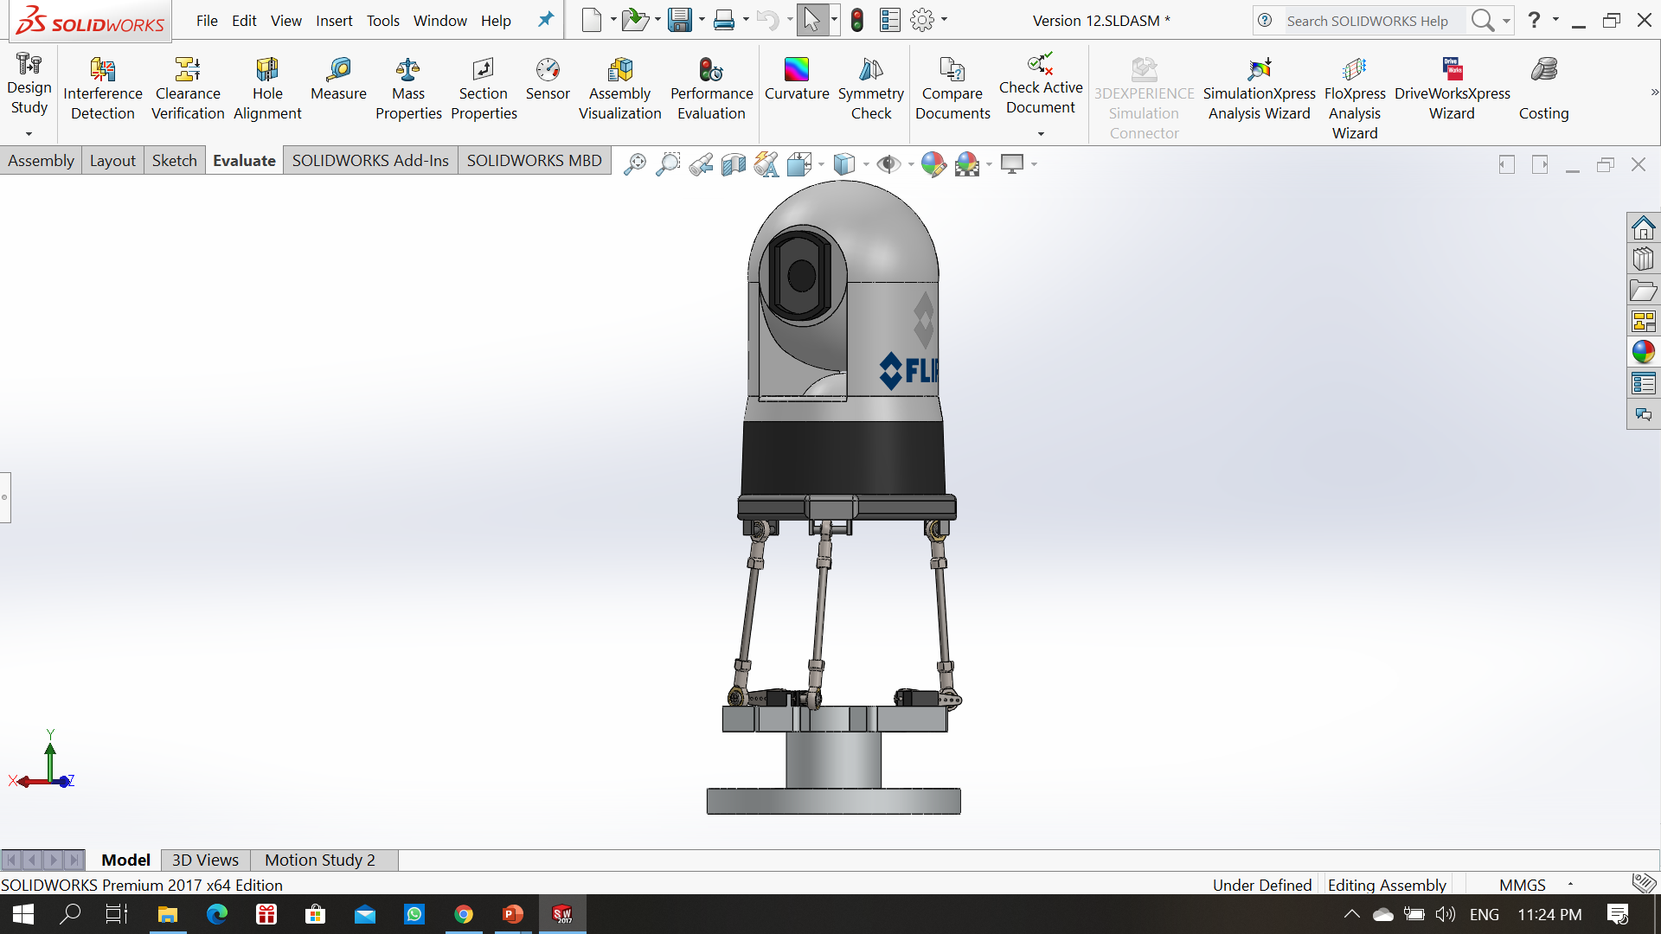
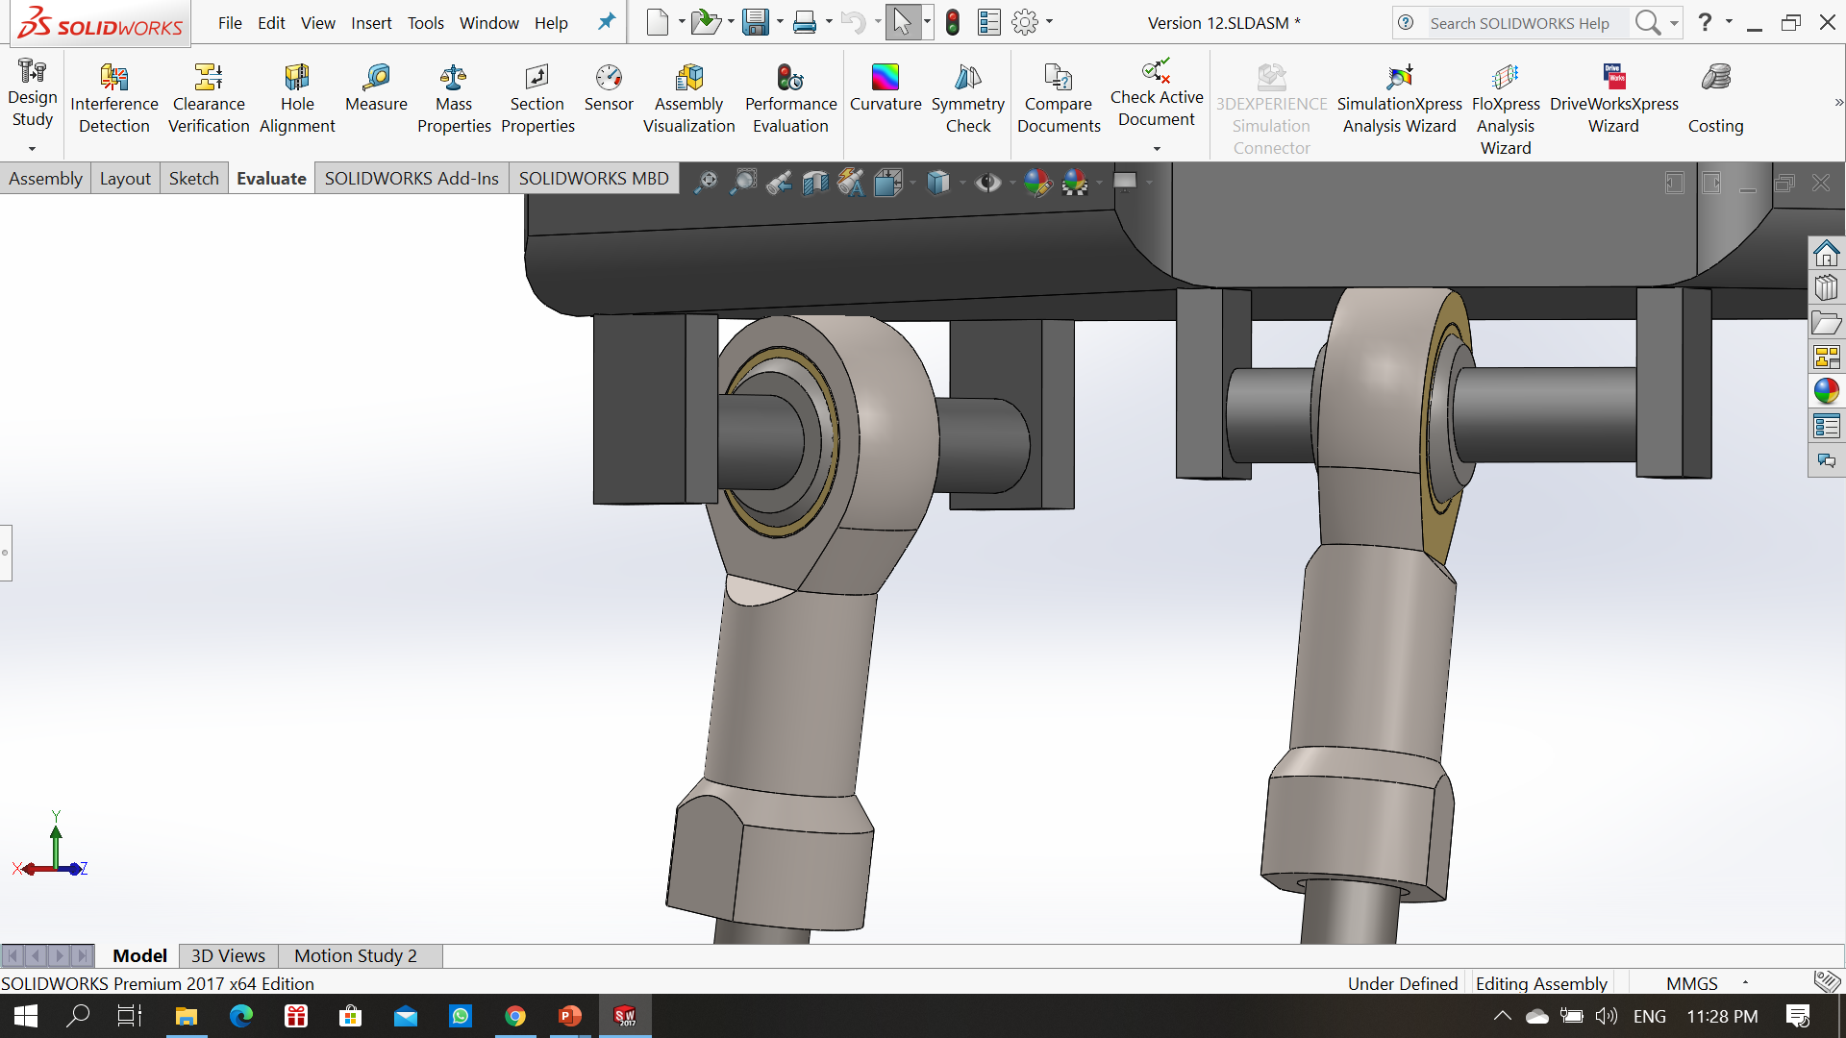
Platform Design and Simulation
6-DOF Stewart Platform
3-DOF Stewart Platform
Ball Joints Design and Servo Arm Design

Slide 37
References
https://en.wikipedia.org/wiki/Parallel_manipulator
Johnson, J., Pillai, R., Vignesh, S. M., & Srinivas, A. L. (2016). Design and kinematic analysis of a 6-DOF parallel manipulator for pharmaceutical application. J. Chem. Pharm. Sci, 9, 3283-3288.
Szufnarowski, F. (2013). Stewart platform with fixed rotary actuators: a low cost design study. Advances in medical Robotics, (4).
Bang, H., & Lee, Y. S. (2018). Implementation of a ball and plate control system using sliding mode control. IEEE Access, 6, 32401-32408.
[1] Shaoqing Ren, Kaiming He, Ross Girshick, and Jian Sun. Faster r-cnn: Towards real-time object detection with region proposal networks. In Advances in neural information processing systems, pages 91–99, 2015
[2] Wei Liu, Dragomir Anguelov, Dumitru Erhan, Christian Szegedy, Scott Reed, Cheng-Yang Fu, and Alexander C Berg. Ssd: Single shot multibox detector. In European conference on computer vision, pages 21–37. Springer, 2016.
[3] J. Redmon and A. Farhadi, “YOLOv3: An Incremental Improvement,” arXiv preprint arXiv:1804.02767, 2018
[4] Jifeng Dai, Yi Li, Kaiming He, and Jian Sun. R-fcn: Object detection via region-based fully convolutional networks. In Advances in neural information processing systems, pages 379–387, 2016.
[5] Hei Law and Jia Deng. Cornernet: Detecting objects as paired keypoints. In Proceedings of the European conference on computer vision, pages 734–750, 2018.
[6] K. Duan, S. Bai, L. Xie, H. Qi, Q. Huang and Q. Tian, "CenterNet: Keypoint Triplets for Object Detection," 2019 IEEE/CVF International Conference on Computer Vision (ICCV)
[7] Law, Hei, Yun Teng, Olga Russakovsky, and Jia Deng. "Cornernet-lite: Efficient keypoint based object detection." arXiv preprint arXiv:1904.08900 (2019).
[9] F. Long, T. Yao, Z. Qiu, X. Tian, J. Luo and T. Mei, "Gaussian Temporal Awareness Networks for Action Localization," 2019 IEEE/CVF Conference on Computer Vision and Pattern Recognition (CVPR)
[10] M. Xu, M. Gao, Y. Chen, L. Davis and D. Crandall, "Temporal Recurrent Networks for Online Action Detection," 2019 IEEE/CVF International Conference on Computer Vision (ICCV)
[11] Jiyang Gao, Zhenheng Yang and Ram Nevatia, "RED: Reinforced encode-decoder networks for action anticipation", BMVC, 2017.
[12] Y. Zhang, P. Tokmakov, M. Hebert and C. Schmid, "A Structured Model for Action Detection," 2019 IEEE/CVF Conference on Computer Vision and Pattern Recognition (CVPR)
[13] X. Yang, X. Yang, M. Liu, F. Xiao, L. S. Davis and J. Kautz, "STEP: Spatio-Temporal Progressive Learning for Video Action Detection," 2019 IEEE/CVF Conference on Computer Vision and Pattern Recognition (CVPR)
[14] G. Singh, S. Saha, M. Sapienza, P. Torr and F. Cuzzolin, "Online Real-Time Multiple Spatiotemporal Action Localisation and Prediction," 2017 IEEE International Conference on Computer Vision (ICCV)
[15] Flask.palletsprojects.com. 2020. Welcome To Flask — Flask Documentation (1.1.X). [online] Available at: https://flask.palletsprojects.com/en/1.1.x/
[16] Djangoproject.com. 2020. The Web Framework For Perfectionists With Deadlines | Django. [online] Available at: https://www.djangoproject.com/
[17] Phoenixframework.org. 2020. Peace-Of-Mind From Prototype To Production. [online] Available at: https://www.phoenixframework.org/
[18] Spring.io. 2020. Spring Boot. [online] Available at: https://spring.io/projects/spring-boot
[19] Expressjs.com. 2020. Express - Node.Js Web Application Framework. [online] Available at: https://expressjs.com/
[20] Reactjs.org. 2020. React – A Javascript Library For Building User Interfaces. [online] Available at: https://reactjs.org/
[21] Angular.io. 2020. Angular. [online] Available at: https://angular.io/
[22] Angularjs.org. 2020. Angularjs — Superheroic Javascript MVW Framework. [online] Available at: https://angularjs.org/
[23] js.foundation, J., 2020. Jquery. [online] Jquery.com. Available at: https://jquery.com/

